Slide 1

Piece of the Py
Analysis of House Prices in the U.S.
Group 3
November 10, 2018

Slide 2

Executive Summary

Slide 3



Analysis Goal
The team wants to identify potential indicators of rising and falling home prices in the United States. As part of the analysis, the team will seek to answer:
What are the historical trends in housing prices?
What are potential indicators of housing prices?
How well do the indicators correlate and indicated the direction of prices?
What will the homebuyers in our team do with this knowledge for their upcoming home purchase?
Findings
The performance of selected inputs to the model do seem to indicate the direction housing prices will move.
However, it’s unclear if any input is to the model directly impacts the price of housing or indicates where prices will move.

Slide 4

Source Data
Potential Inputs
The team brainstormed potential indicators of home prices and listed a few that would most likely either precede a change in prices or directly influence home purchases.
Home prices is the primary Y metric for the data, evaluating both Nationally and Regionally
Fed Funds Rate directly influences lending rates and therefore, the resultant buying power
Unemployment Rate & Consumer Income levels indicate the populations ability to buy
The performance of the S&P suggests the direction of the overall economy
Primary source data: Fred – Federal Reserve Bank of St. Louis
Housing prices – nationally and regionally
Fed Funds Rate
Unemployment rates
Consumer Income
Bloomberg – S&P index performance

Slide 5

Data Exploration and Clean Up
The inputs selected as part of the analysis were the result of the data exploration employed by the team.
The original list of candidates was longer but based on data and API availability (e.g. e-trade), the inputs were narrowed down to the 5
Once the inputs were selected, a few common challenges were uncovered:
Pulling data with similar time periods
Merging, cleaning and comparing data due to data range differences
Manipulating data and computing QOQ /YOY change resulted in NAN’s in the dataframes
Normalizing data points for comparison
Conflicting outcomes on regression tests when using actual dollars vs inflation adjusted index

Slide 6
Data Analysis Steps
The team wants to identify potential indicators of rising and falling home prices in the United States. As part of the analysis, the team will seek to answer:
Select potential inputs to analyze against housing prices
Chart and analyze trends in housing prices over time by US & region
Run statistical analysis between inputs and actual housing price
Calculate the percent change over time for the inputs and prices
Normalize Data by removing the average change over the entire timespan and analyze to assess statistical significance
Conduct a final regression analysis of all inputs and determine input significance

Slide 7

Housing Prices
Historical United State Housing prices from 1974 to 2018

Slide 8
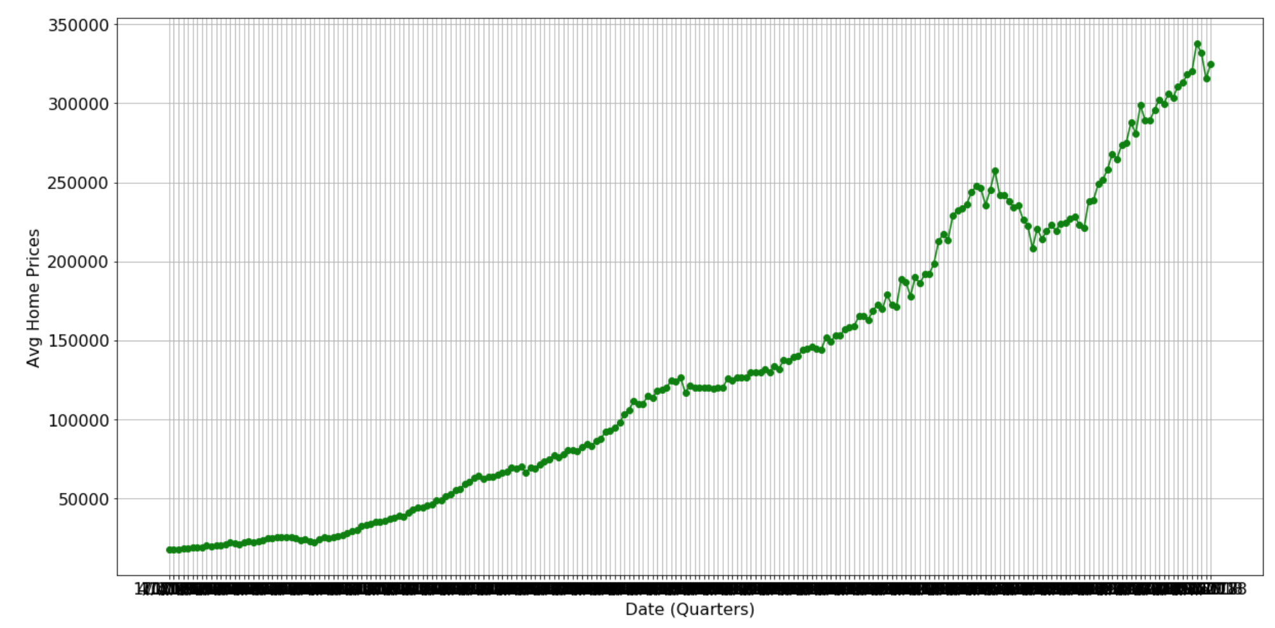
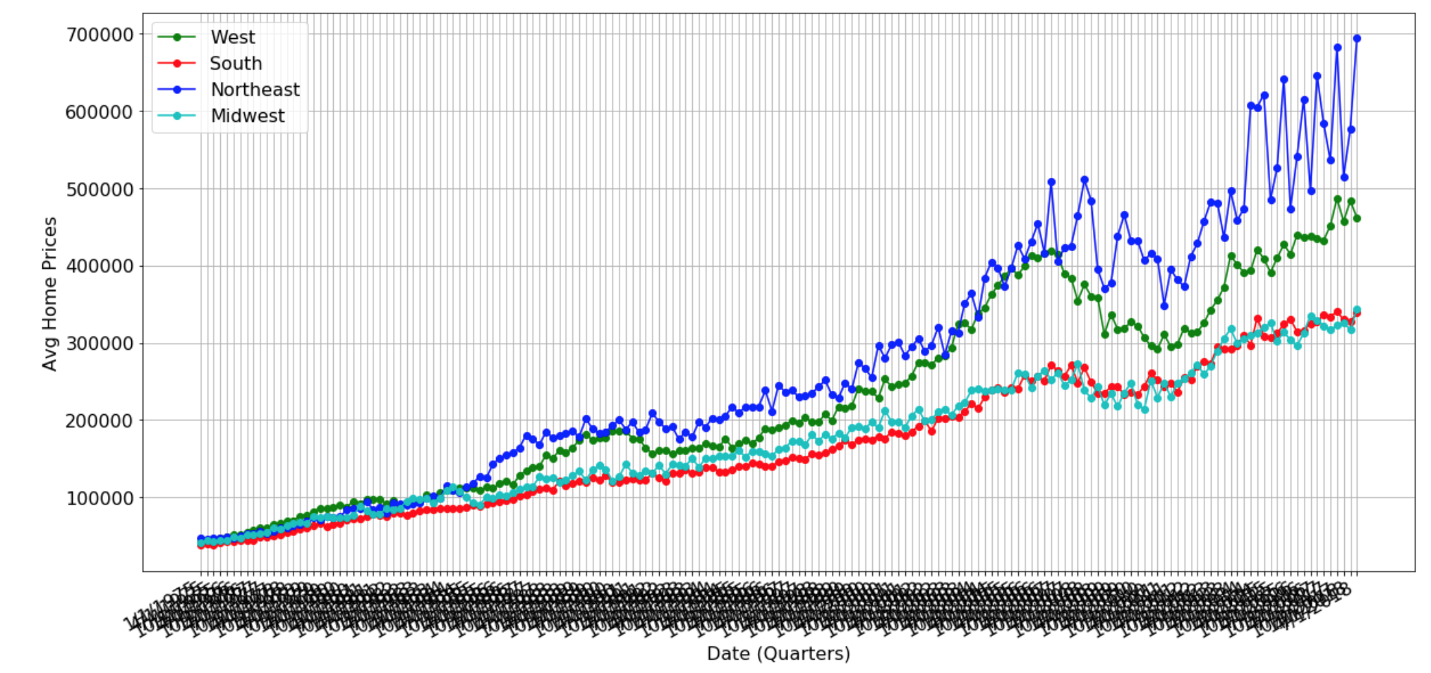

National & Regional Housing Price Trends 1975 - 2018
FRED data provided on a quarterly basis
The source provides sufficient data for analysis as long as comparison data was available.
For other inputs, the team focused the last 10 years for statistical analysis

Slide 9
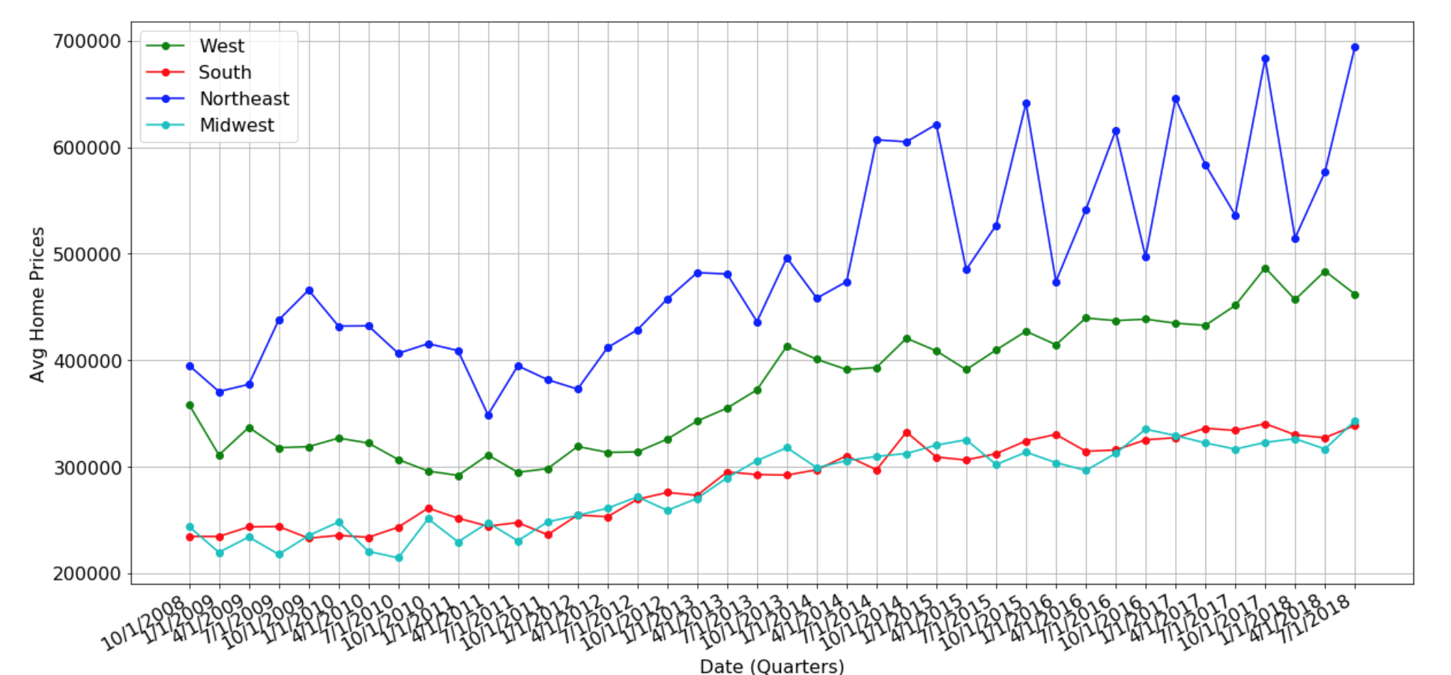
National & Regional Housing Price Trends 1975 - 2018
As apparent by the chart, the Northeast and West regions have significantly different average home prices
The South and Midwest homes are the same on average
All Regions
South & Midwest Regions

Slide 10
Fed Funds Rate
Historical Fed Funds Rate from 1974 to 2018

Slide 11
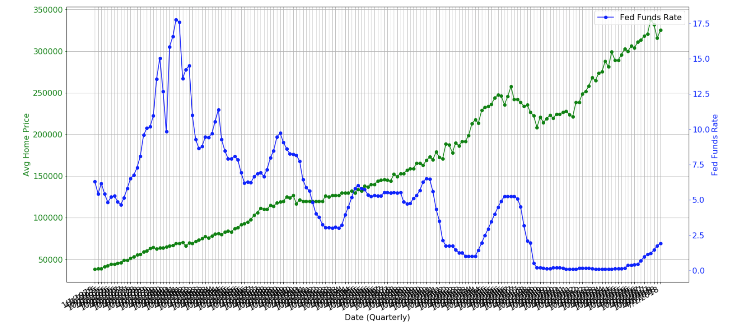
Correlation between Fed Funds and Actual Home Prices
January 1975 – October 2018
Correlation
Proseware
Since 1975 the Fed Funds rate has steadily dropped while Average Home Prices increased
Spikes in rates did cause prices to level off or drop.
Regression analysis would confirm the relationship
Nulla a erat eget nunc hendrerit ultrices eu nec nulla. Donec viverra leo aliquet, auctor quam id, convallis orci.
Sed in molestie est. Cras ornare turpis at ligula posuere, sit amet accumsan neque lobortis.
Maecenas mattis risus ligula, sed ullamcorper nunc efficitur sed.
Correlation Coefficient

Slide 12
Unemployment Rate
Historically for the U.S. and by census region

Slide 13
Unemployment Rates v Housing Prices
While the data seems erratic, overall, there visually appears to be an inverse relationship between housing prices and unemployment rates (as house prices rise, unemployment decreases).
The chi squared value shows that there is not a statistical significance between the means of the two datasets.
While the correlation coefficient shows an inverse relationship between the two.
National view from Oct 2008 through June 2018
 | Value
Chi Squared | 1.0
Correlation | -0.32

Slide 14
Unemployment Rates v Housing Prices
Regional view from Oct 2008 through June 2018 : NorthEast
There is more variance with average housing prices over the 10 year period in the Northeast compared to unemployment rates, but the inverse trend still remains.
Correlation coefficient was calculated and showed a strong negative correlation between the two.
 | Value
Chi Squared | 1.04
Correlation | -0.74

Slide 15
Unemployment Rates v Housing Prices
Regional view from Oct 2008 through June 2018 : MidWest
The Midwest census region shows the opposite trends from the rest of the nation. Unemployment rates move a little more in tandem with housing prices.
The correlation is positive 0.02.
 | Value
Chi Squared | 0.11
Correlation | 0.02

Slide 16
Unemployment Rates v Housing Prices
Regional view from Oct 2008 through June 2018 : West
In the West, housing prices continue to vary more wildly then unemployment.
Visually there is not a clear trend.
The correlation coefficient shows a slight inverse relationship between to the measures.
 | Value
Chi Squared | 0.66
Correlation | -0.11

Slide 17
Unemployment Rates v Housing Prices
Regional view from Oct 2008 through June 2018 : South
Similarly to the West, the South census region does not visually show a clear trend.
The correlation shows a slight relationship while the Chi squared an equal variance from the mean.
 | Value
Chi Squared | 0.28
Correlation | 0.13

Slide 18
Personal Income

Slide 19
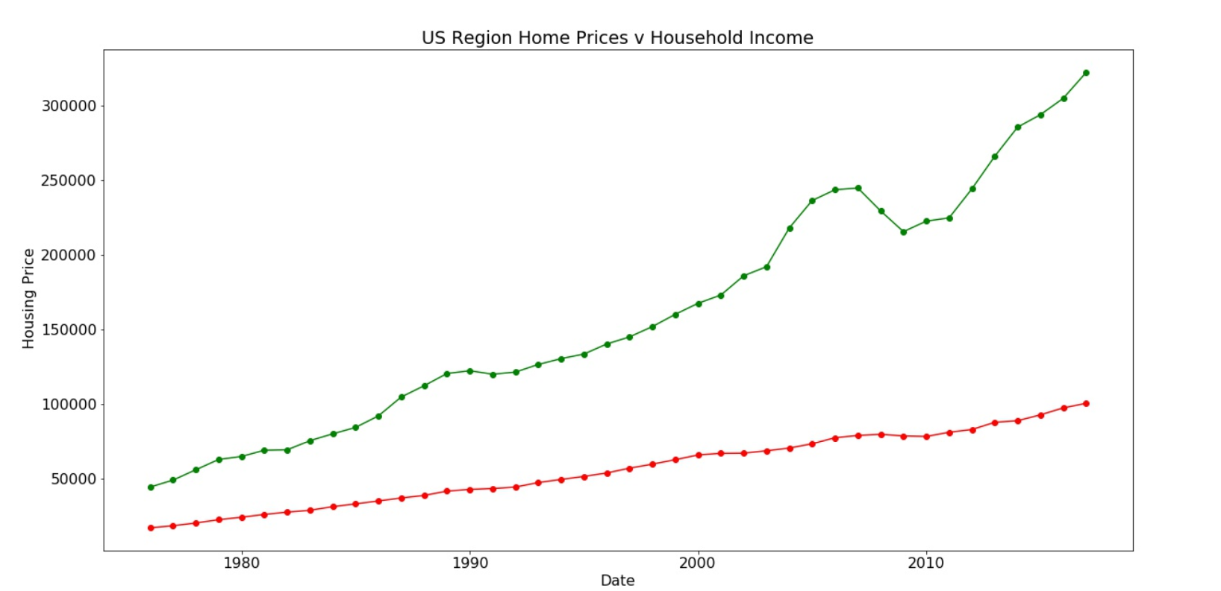
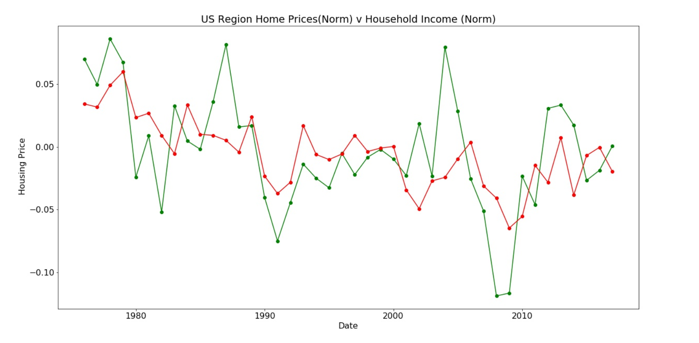
Annual US Income VS Housing Prices
The below graphs depicts the annual US income against US Housing Prices
The annual Income has seen steady and gradual increase till 2017
The Annual US housing prices also show steady growth with major downfall around 2008
Corr (Graph1)= 0.9874363971778967
The second Graph depicts the year on year change in Income and Household prices.
Corr (Graph2)= 0.562822727768101

Slide 20
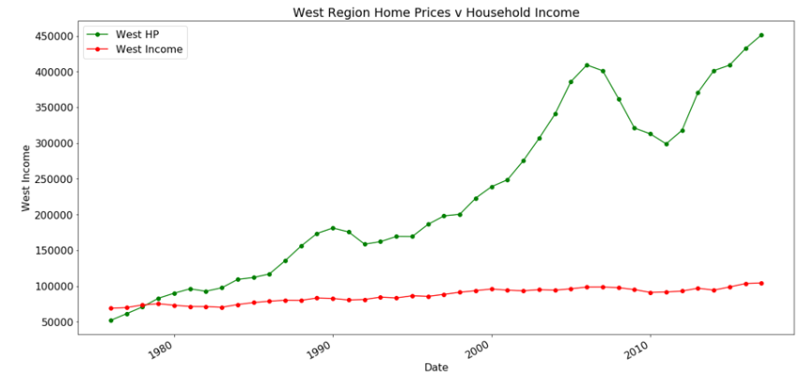
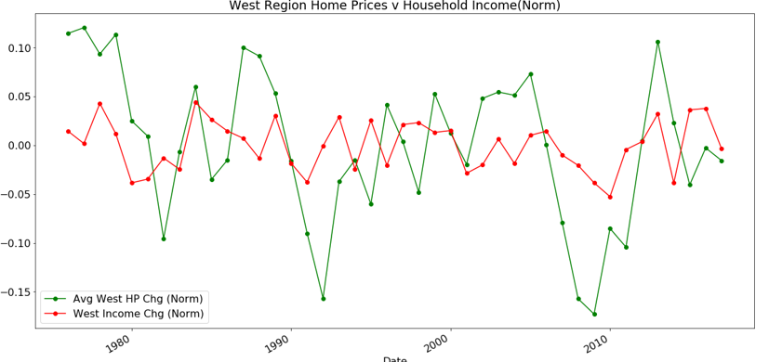
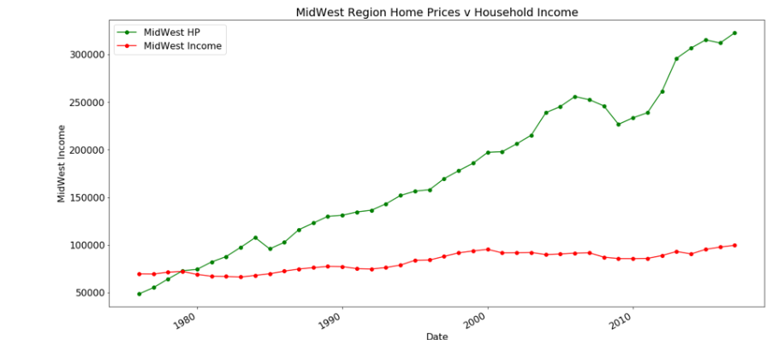
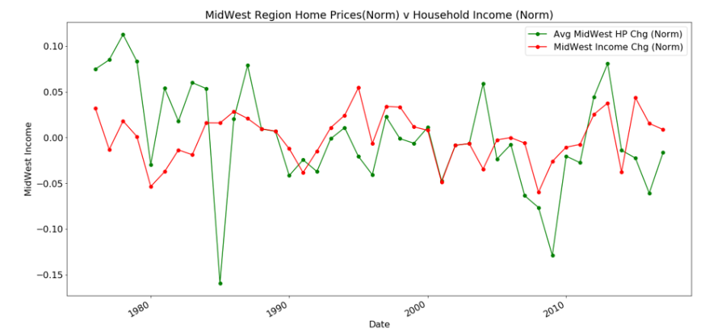
Annual US Income VS Housing Prices Region Level
The below graphs depicts the annual US income against US Housing Prices for West and Mid West Region
Early 70’s – The income was higher than the housing price for West & MW region
The normalised data show more dips for Housing prices in West than in Mid west
Corr West = 0.9430650391911549
Corr West(Norm)=0.33453760202008065
Corr M-West = 0.9016640812020873
Corr M-West (Norm)=0.2607926346973953

Slide 21
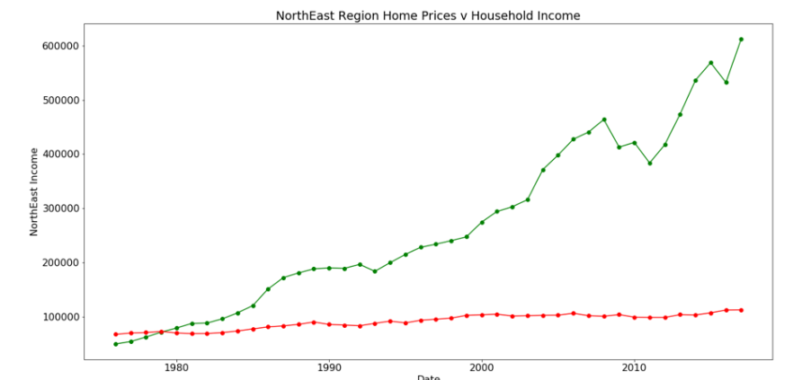
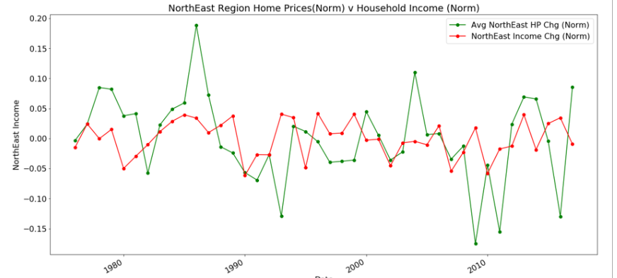
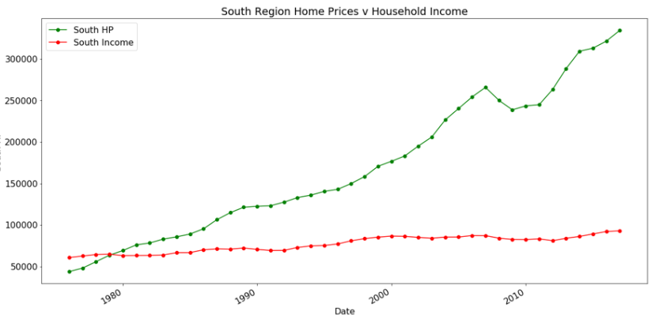
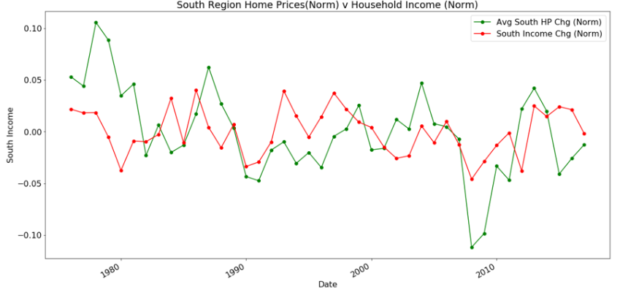
Annual US Income VS Housing Prices Region Level
The below graphs depicts the annual US income against US Housing Prices North East and South Region
North East region seems most volatile from all the 4 regions with max housing prices dip
Corr NE = 0.9049753354900574
Corr NE(Norm)=0.10368327318093802
Corr South = 0.9195335517729698
Corr South(Norm)=0.29477451905592733

Slide 22
US Home Prices vs Sector Performance

Slide 23
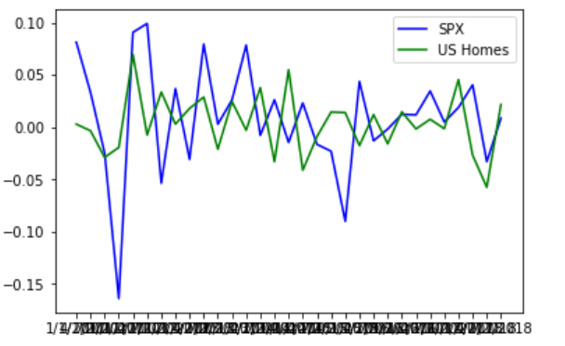
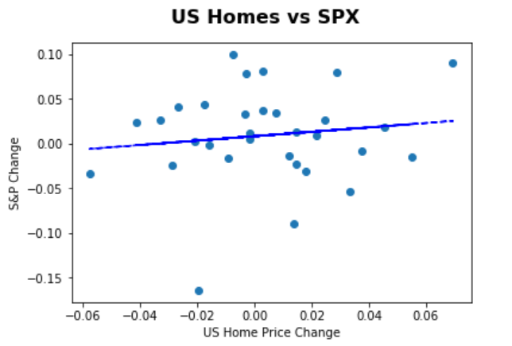
US Home Prices vs S&P 500
Weak positive correlation between S&P 500 and housing prices
Suggests there’s no direct relationship between the change in Home prices and Stock market performance
 | Value
Correlation | 0.13

Slide 24
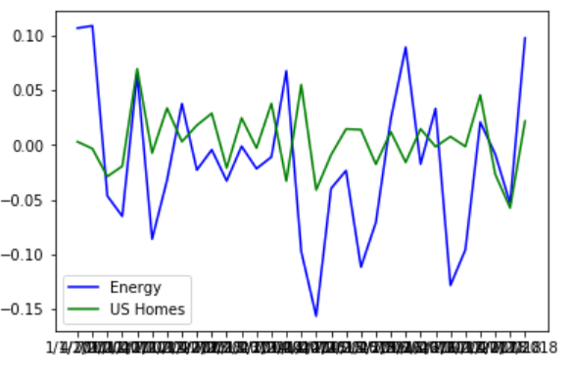
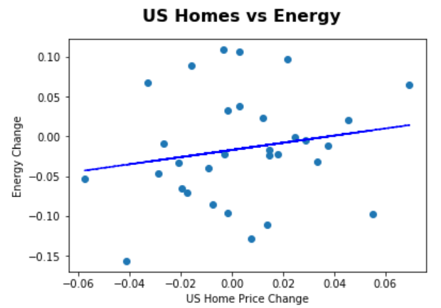
US Home Prices vs Energy Sector
Weak positive correlation between Energy Sector and housing prices
Suggests there’s no direct relationship between the change in Home prices and Energy sector
Correlation might be skewed by outlier periods. See line charts.
 | Value
Correlation | 0.18

Slide 25
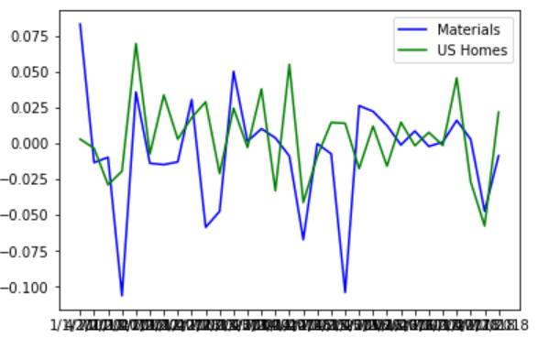
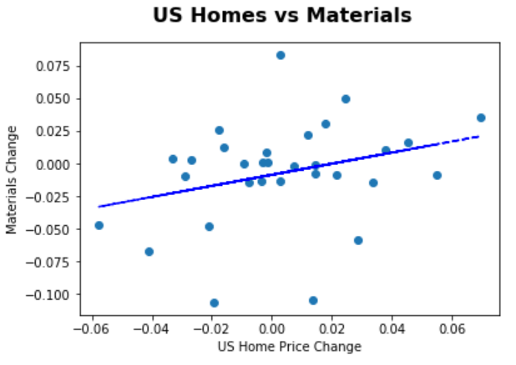
US Home Prices vs Materials Sector
Positive correlation between Material Sector and housing prices
Suggests there’s some direct relationship between the change in Home prices and Material sector. I.e. Construction costs.
 | Value
Correlation | 0.30

Slide 26
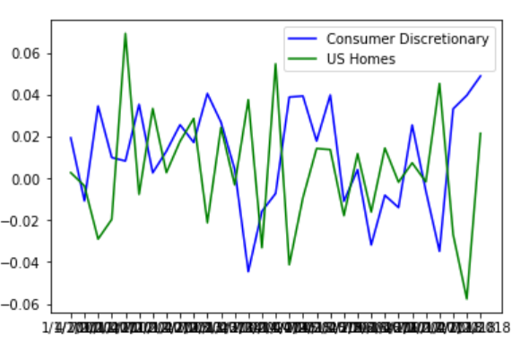
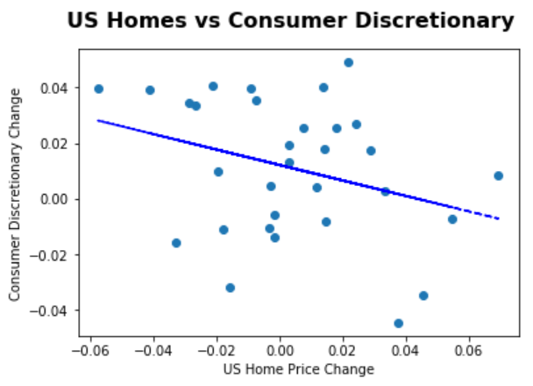
US Home Prices vs Consumer Discretionary Sector
Negative correlation between Consumer Discretionary Sector and housing prices
Suggests consumer spending on non-essentials driving down real estate demand.
 | Value
Correlation | -0.31

Slide 27
Regression Analysis

Slide 28
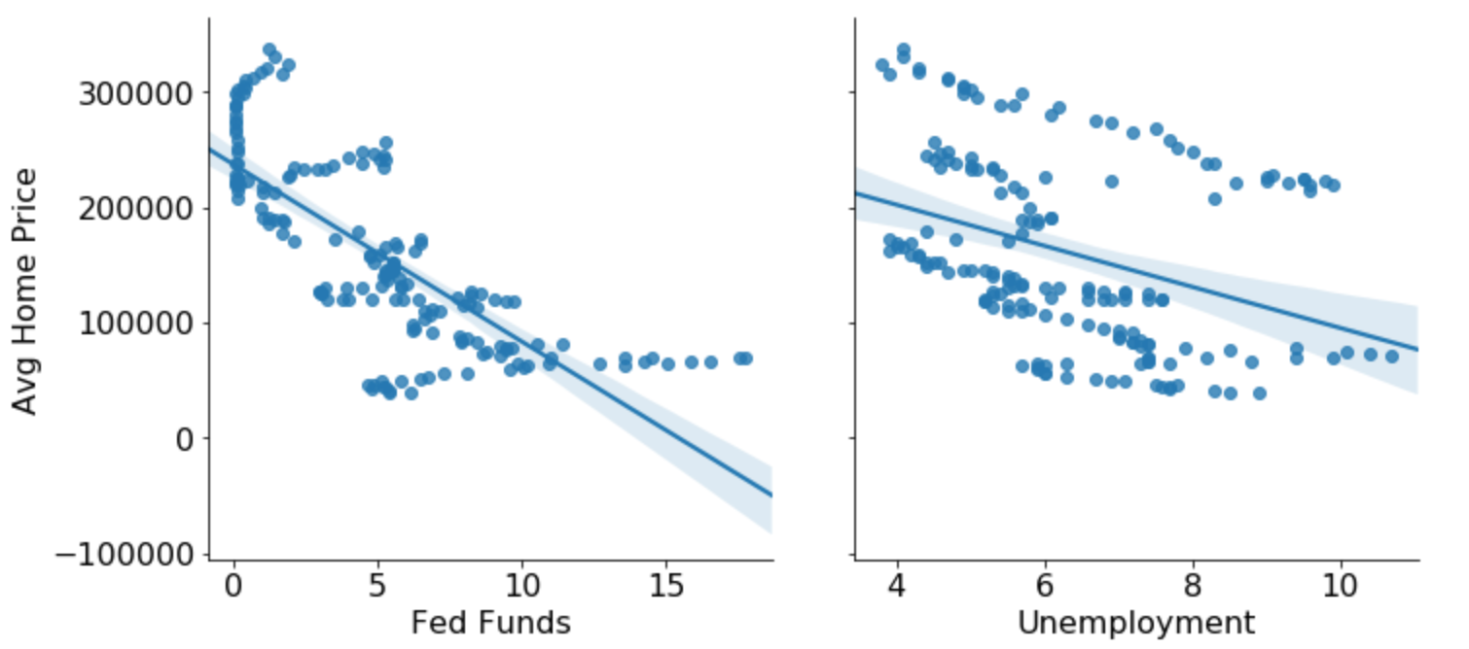
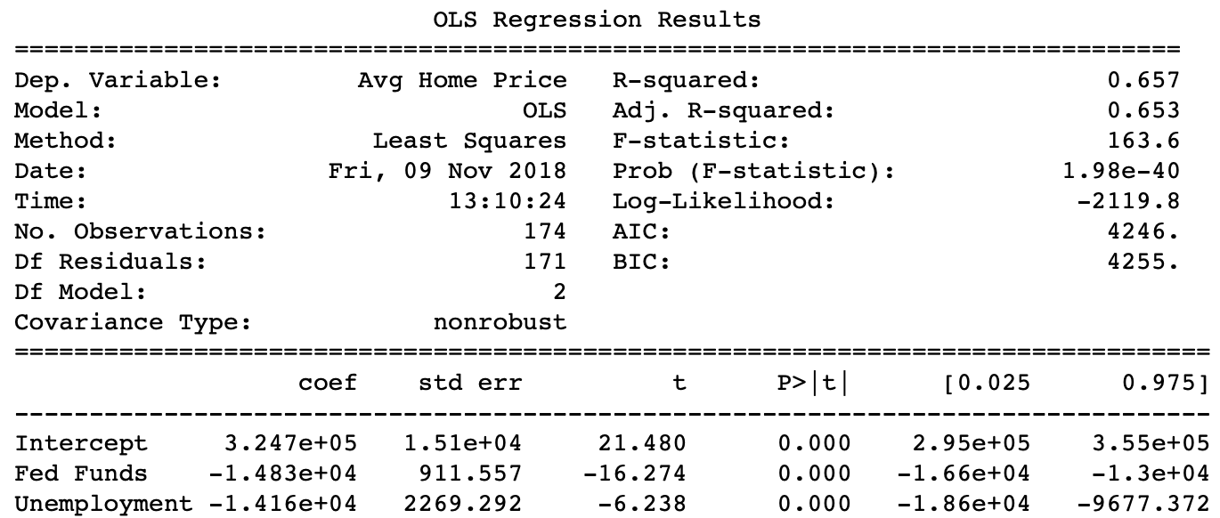
Regression analysis – Fed Funds Rate & Unemployment
January 1975 – October 2018
Individual Regression Plots
Regression Summary
Both inputs have a significant impact on housing prices
R2 value of 65.7% would suggest that the model is not very strong and further inputs need to be added to explain variation in housing data
Both inputs have a significant impact on housing prices
R2 value of 65.7% would suggest that the model is not very strong and further inputs need to be added to explain variation in housing data

Slide 29
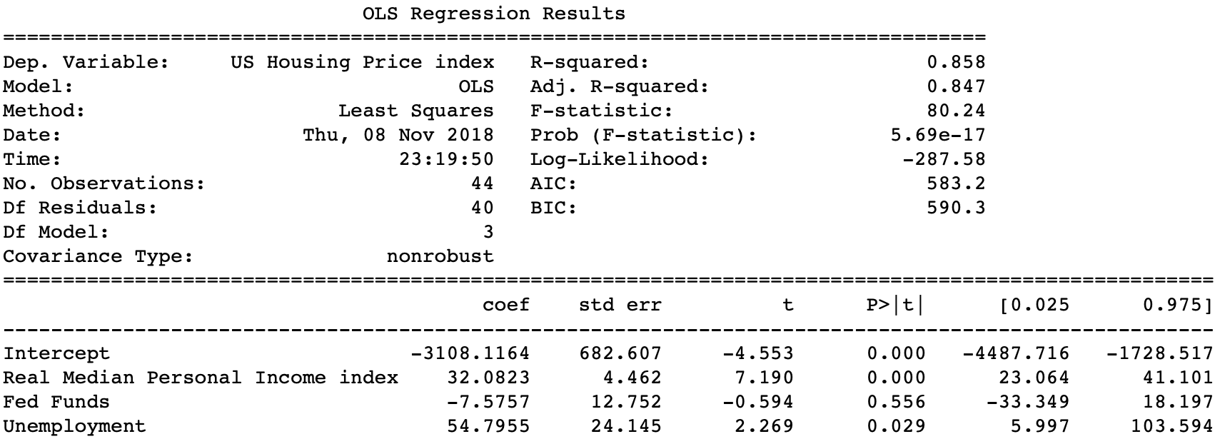
Regression analysis – Fed Funds & Unemp & Income
A second data pull leveraged an inflation adjusted index value for Housing prices and an additional input - January 1974 – October 2018
Regression Summary
R2 value increased to 85.8% suggesting a much stronger model than the prior analysis
However, this model indicates that the Fed Funds Rate is not significant in housing prices
Further addition of inputs would be required to make a satisfactory model for housing prices
R2 value increased to 85.8% suggesting a much stronger model than the prior analysis
However, this model indicates that the Fed Funds Rate is not significant in housing prices
Further addition of inputs would be required to make a satisfactory model for housing prices

Slide 30
Thank You

